Slide 1

Numerical Integration
不正经讲师：理科宅Hunt

Slide 2

Closed Newton-cotes formula
Suppose there are $n+1$ equally-spaced nodes, i.e. $x_{i}=x_{0}+ih$ where $x_{0}=a,x_{n}=b$ and $h=(b−a)/n$. By Lagrange interpolation, we have
$$f\left(x\right)=\sum_{i=0}^{n}{f\left(x_{i}\right)L_{i}(x)}+\frac{f^{\left(n+1\right)}\left(ξ(x)\right)}{\left(n+1\right)!}\prod_{i=0}^{n}{\left(x−x_{i}\right)}$$
Where $L_{i}(x)=\prod_{k≠i}^{n}{\frac{x−x_{i}}{x_{k}−x_{i}}}$ .
Then, by weighted mean value theorem and change of variable, we have
$$\int_{a}^{b}{f\left(x\right)dx}=\sum_{i=0}^{n}{f\left(x_{i}\right)\int_{a}^{b}{L_{i}\left(x\right)dx}}+\frac{h^{n+3}f^{\left(n+1\right)}\left(ξ\right)}{\left(n+2\right)!}\int_{0}^{n}{t^{2}\left(t−1\right)⋯(t−n)dt}$$
If $n$ is even and $f∈C^{n+2}[a,b]$.
$$\int_{a}^{b}{f\left(x\right)dx}=\sum_{i=0}^{n}{f\left(x_{i}\right)\int_{a}^{b}{L_{i}\left(x\right)dx}}+\frac{{h^{n+2}f}^{\left(n+1\right)}\left(ξ\right)}{\left(n+1\right)!}\int_{0}^{n}{t\left(t−1\right)⋯(t−n)dt}$$
If $n$ is odd and $f∈C^{n+1}[a,b]$.

Slide 3
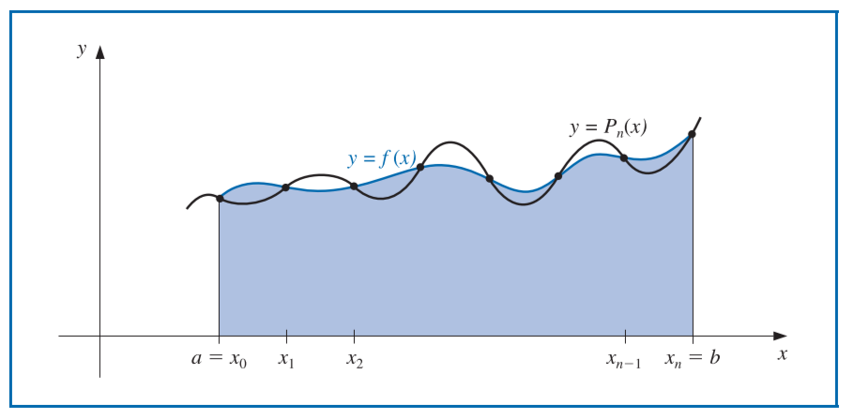
Graph for deriving closed Newton-Cotes formula

Slide 4
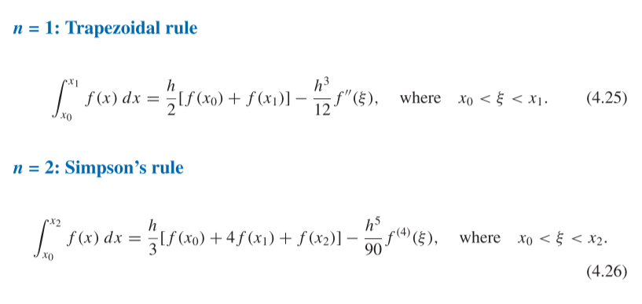
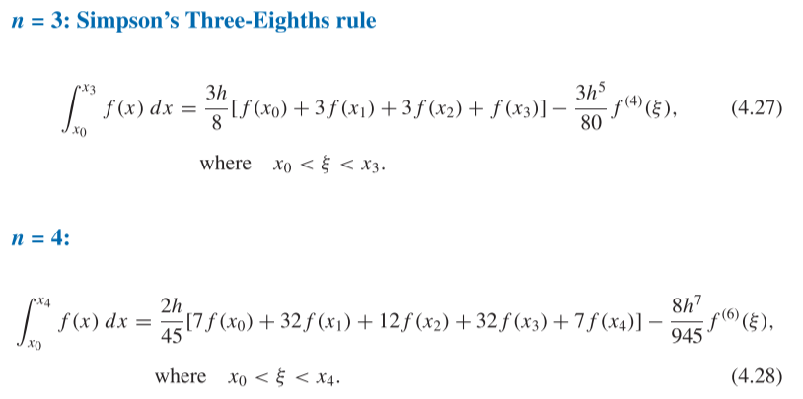
Commonly used Closed Newton-Cotes formula

Slide 5

Open Newton-cotes formula
Suppose there are $n+1$ equally-spaced nodes, i.e. $x_{i}=x_{0}+ih$ where $x_{0}=a+h,x_{n}=b−h$ and $h=(b−a)/(n+2)$. By Lagrange interpolation, we have
$$f\left(x\right)=\sum_{i=0}^{n}{f\left(x_{i}\right)L_{i}(x)}+\frac{f^{\left(n+1\right)}\left(ξ(x)\right)}{\left(n+1\right)!}\prod_{i=0}^{n}{\left(x−x_{i}\right)}$$
Where $L_{i}(x)=\prod_{k≠i}^{n}{\frac{x−x_{i}}{x_{k}−x_{i}}}$ .
Then, by weighted mean value theorem and change of variable, we have
$$\int_{a}^{b}{f\left(x\right)dx}=\sum_{i=0}^{n}{f\left(x_{i}\right)\int_{a}^{b}{L_{i}\left(x\right)dx}}+\frac{h^{n+3}f^{\left(n+1\right)}\left(ξ\right)}{\left(n+2\right)!}\int_{−1}^{n}{t^{2}\left(t−1\right)⋯(t−n)dt}$$
If $n$ is even and $f∈C^{n+2}[a,b]$.
$$\int_{a}^{b}{f\left(x\right)dx}=\sum_{i=0}^{n}{f\left(x_{i}\right)\int_{a}^{b}{L_{i}\left(x\right)dx}}+\frac{{h^{n+2}f}^{\left(n+1\right)}\left(ξ\right)}{\left(n+1\right)!}\int_{−1}^{n}{t\left(t−1\right)⋯(t−n)dt}$$
If $n$ is odd and $f∈C^{n+1}[a,b]$.

Slide 6
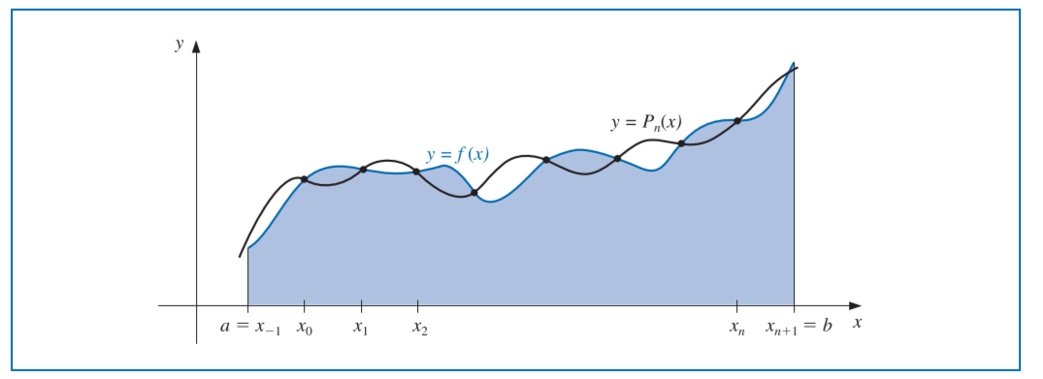
Graph for deriving closed Newton-Cotes formula

Slide 7
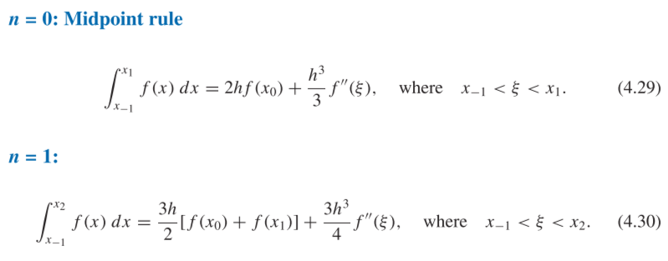
Commonly used Closed Newton-Cotes formula

Slide 8
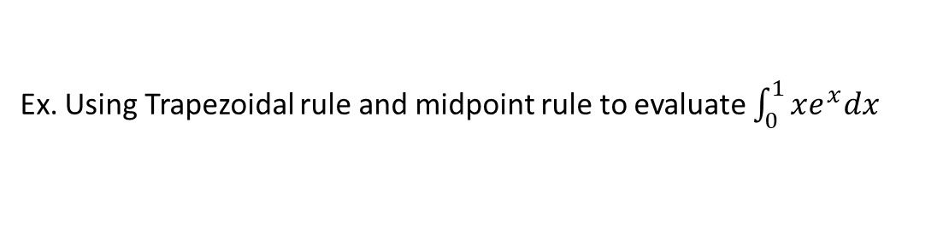
Example
Ex. Using Trapezoidal rule and midpoint rule to evaluate $\int_{0}^{1}{xe^{x}dx}$

Slide 9
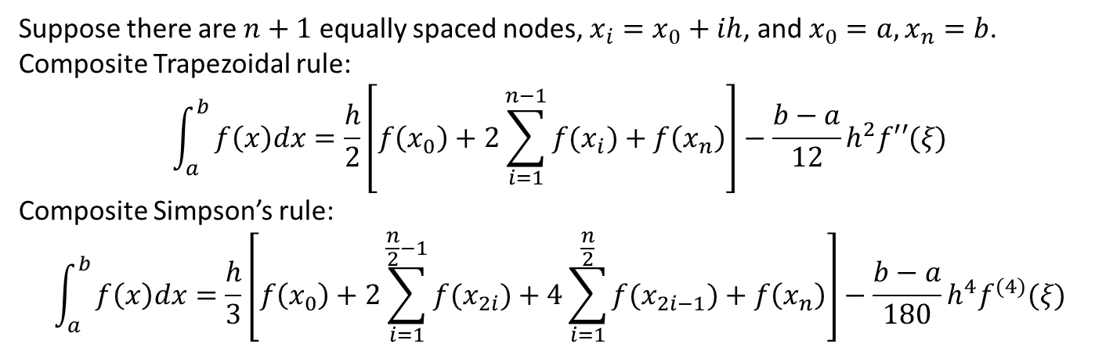
Composite formulas
Suppose there are $n+1$ equally spaced nodes, $x_{i}=x_{0}+ih$, and $x_{0}=a, x_{n}=b$.
Composite Trapezoidal rule:
$$\int_{a}^{b}{f\left(x\right)dx=\frac{h}{2}\left[f\left(x_{0}\right)+2\sum_{i=1}^{n−1}{f(x_{i})}+f\left(x_{n}\right)\right]−\frac{b−a}{12}h^{2}f′′(ξ)}$$
Composite Simpson’s rule:
$$\int_{a}^{b}{f\left(x\right)dx=\frac{h}{3}\left[f\left(x_{0}\right)+2\sum_{i=1}^{\frac{n}{2}−1}{f(x_{2i})}+4\sum_{i=1}^{\frac{n}{2}}{f(x_{2i−1})}+f\left(x_{n}\right)\right]−\frac{b−a}{180}h^{4}f^{(4)}(ξ)}$$

Slide 10
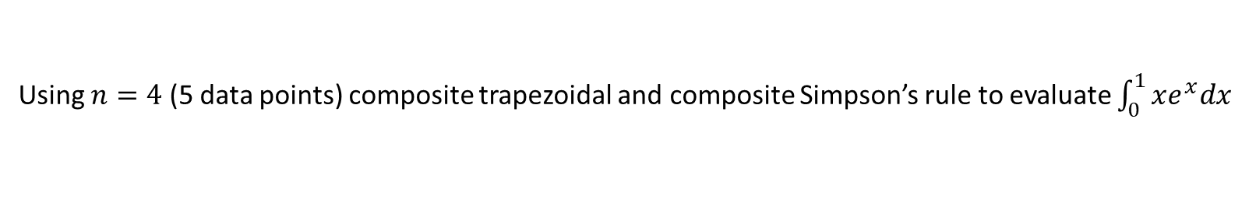
Example
Using $n=4$ (5 data points) composite trapezoidal and composite Simpson’s rule to evaluate $\int_{0}^{1}{xe^{x}dx}$

Slide 11
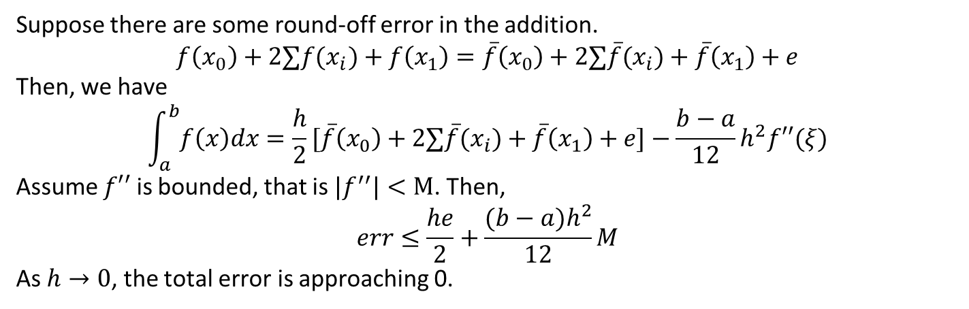
Round-off error stability
Suppose there are some round-off error in the addition.
$$f\left(x_{0}\right)+2∑f(x_{i})+f\left(x_{1}\right)=\overline{f}\left(x_{0}\right)+2∑\overline{f}(x_{i})+\overline{f}\left(x_{1}\right)+e$$
Then, we have
$$\int_{a}^{b}{f\left(x\right)dx}=\frac{h}{2}[\overline{f}\left(x_{0}\right)+2∑\overline{f}(x_{i})+\overline{f}\left(x_{1}\right)+e]−\frac{b−a}{12}h^{2}f′′(ξ)$$
Assume $f′′$ is bounded, that is ${|f}^{′′}|<M$. Then,
$$err≤\frac{he}{2}+\frac{(b−a)h^{2}}{12}M$$
As $h→0$, the total error is approaching 0.

Slide 12
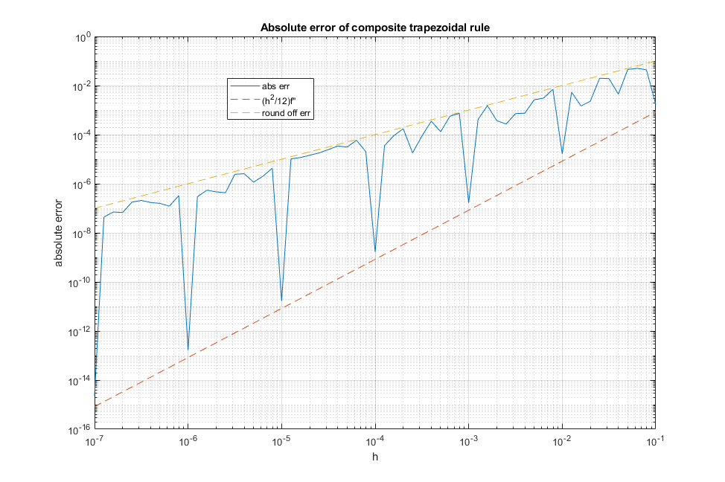
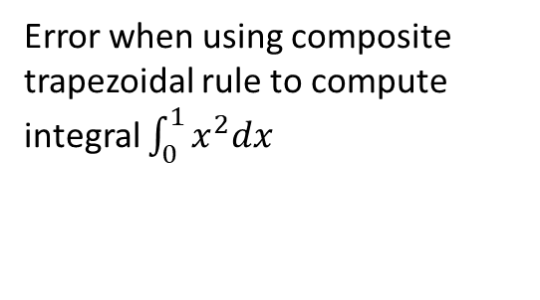
Round-off error stability
Error when using composite trapezoidal rule to compute integral $\int_{0}^{1}{x^{2}dx}$

Slide 13
Conclusion – 总结
Closed\Open Newton-Cotes formulas
Composite formulas
Integral is stable under round-off error

